Slide 1
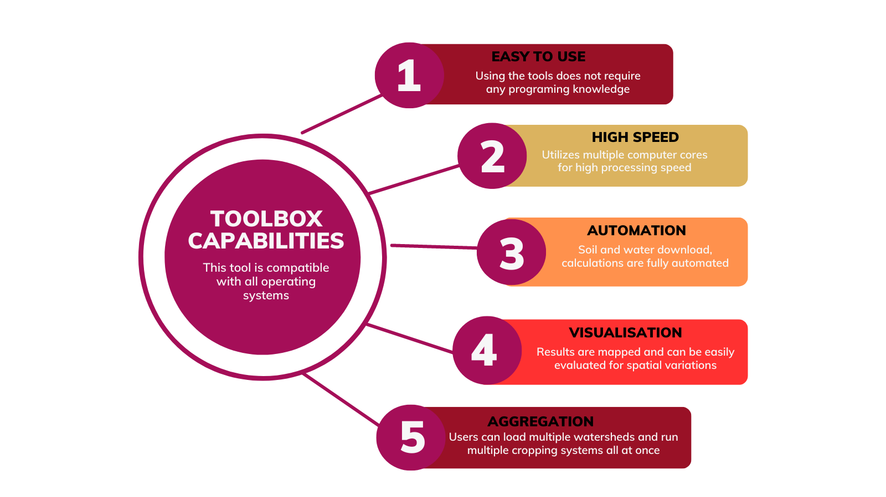
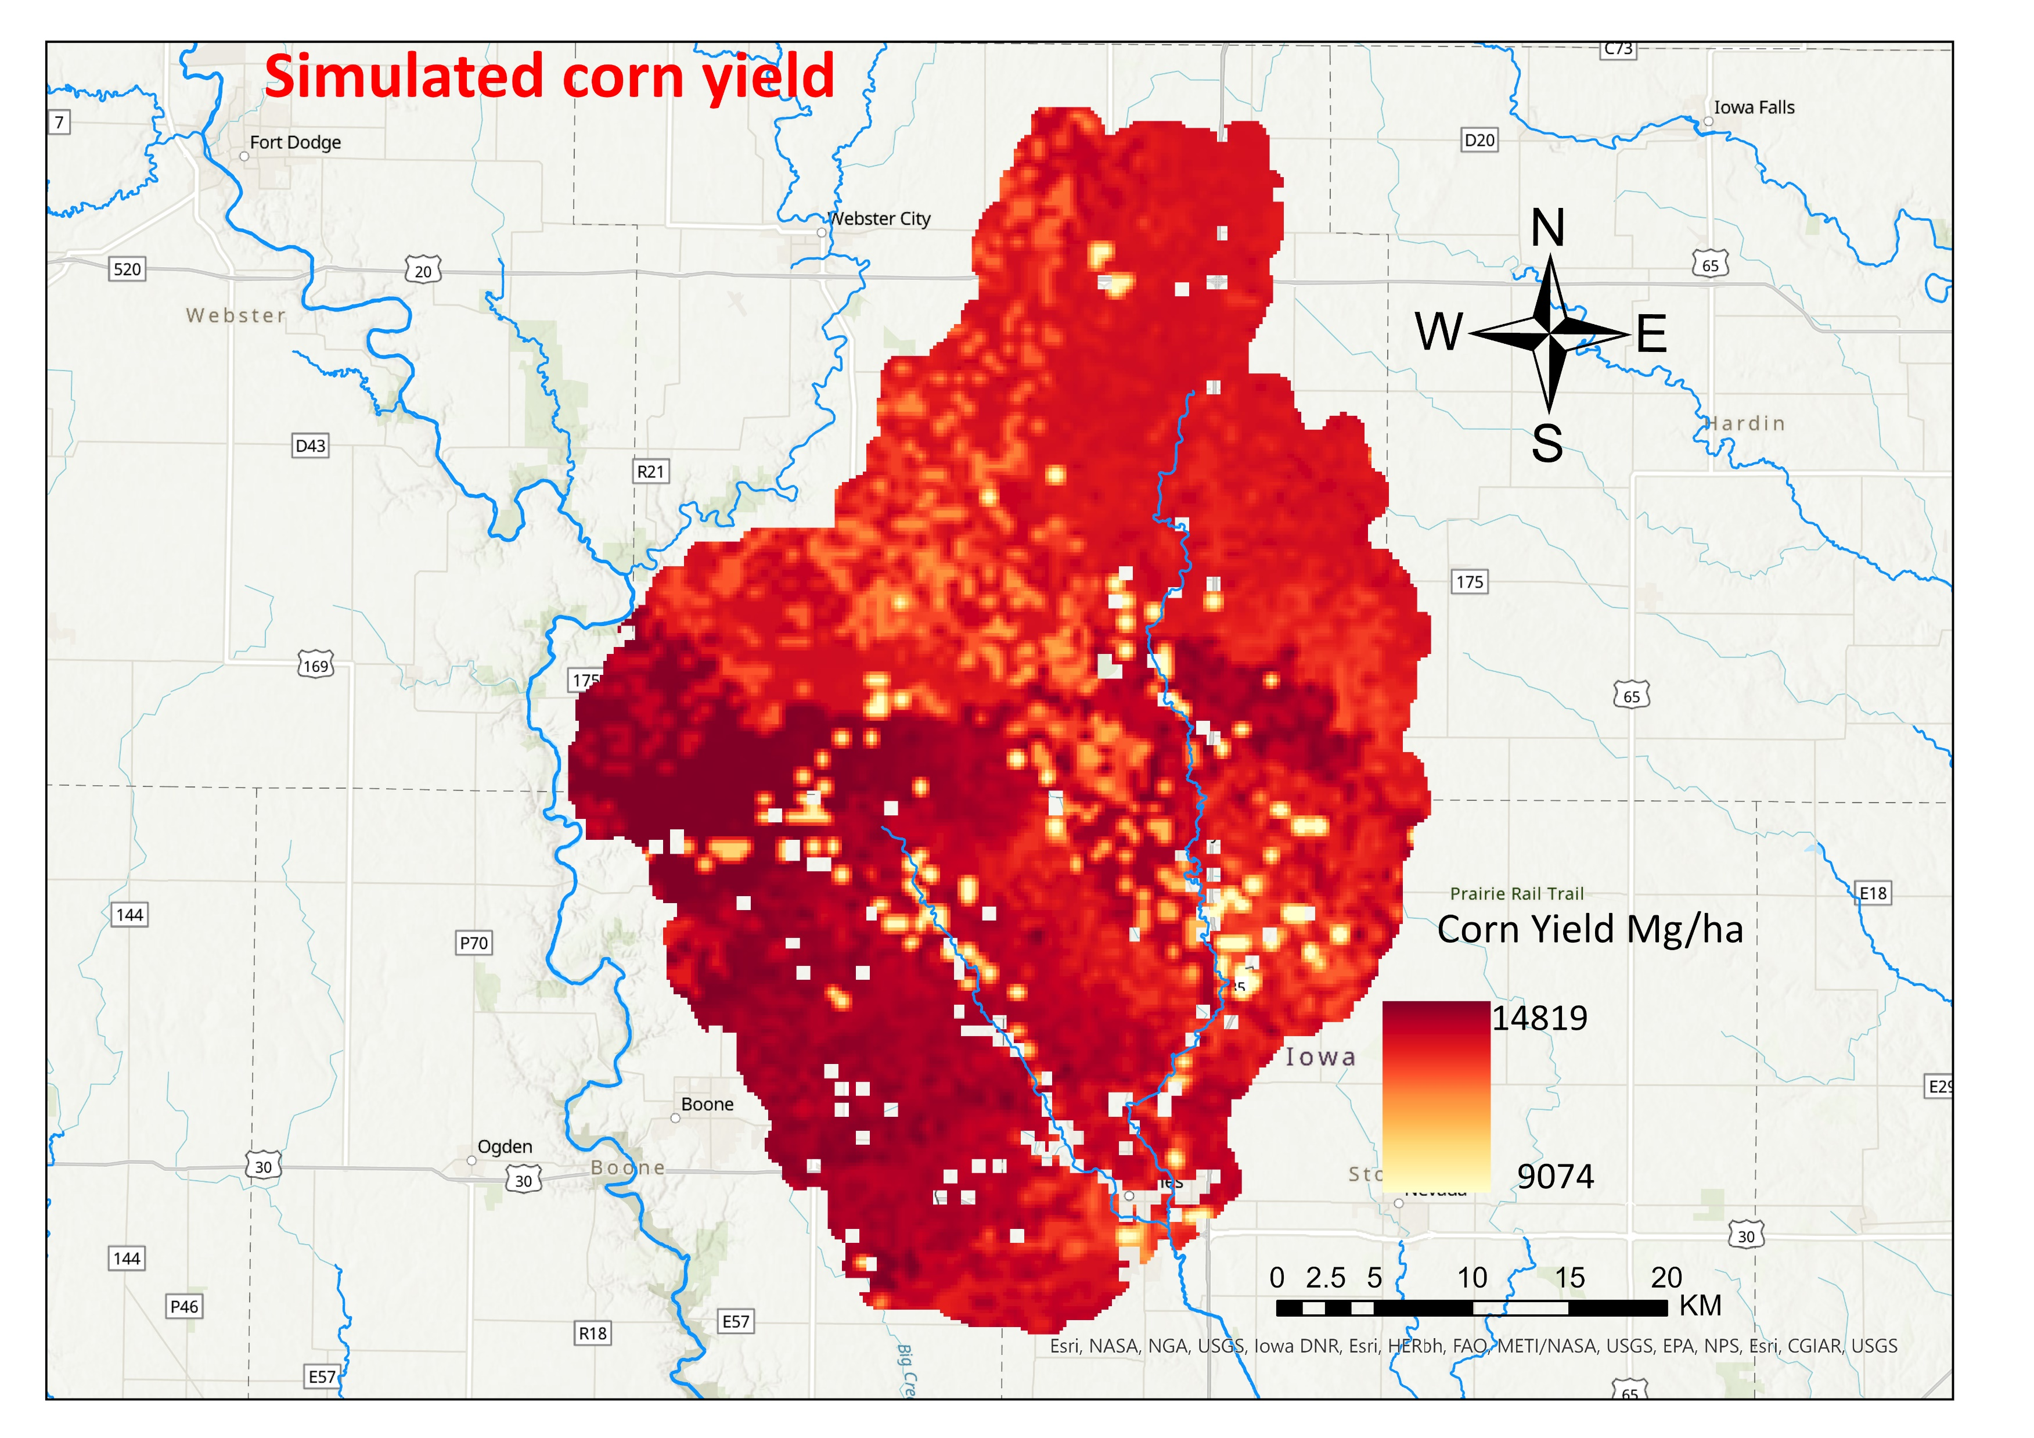
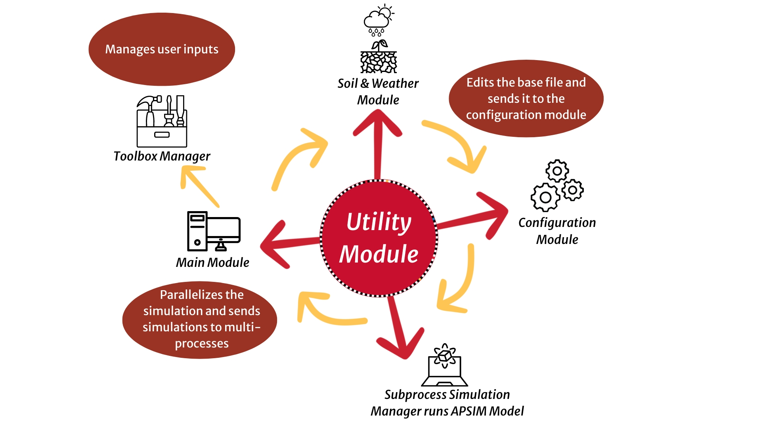
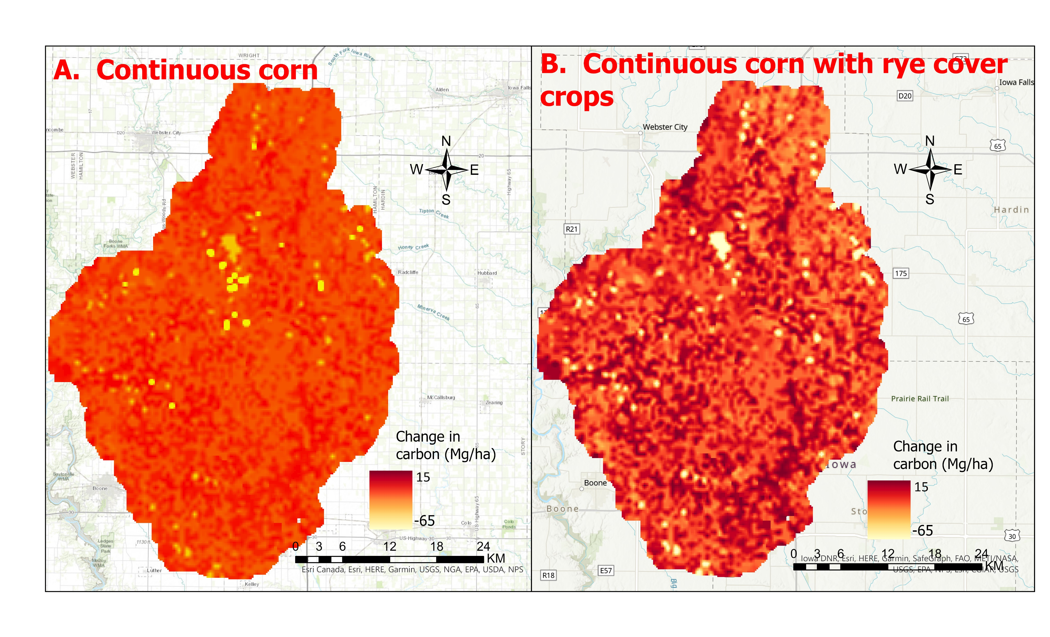
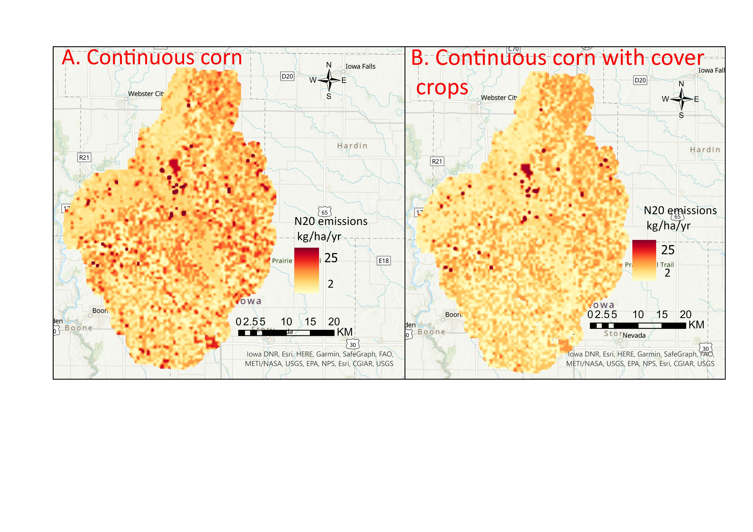

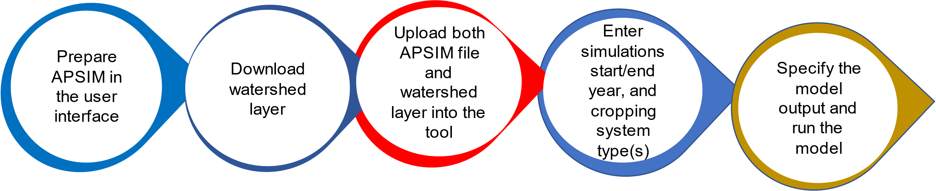

Converting a Process-based Point Model into a Spatial Simulation Tool:
A Simplified Approach for Running and Mapping APSIM Batch Simulations on a Spatial Scale
Richard Magala (rmagala@iastate.edu), John Tyndall, and Lisa Schulte Moore Natural Resource Ecology and Management, Iowa State University
BACKGROUND
Modeling carbon and nitrogen dynamics in agricultural land-scapes is crucial to improving the understanding and manage-ment of air, soil, and water resources.
Simulating these processes over large spatial extents can be challenging as most existing process-based agroecosystem models are point based. Yet, the effects of cropland manage-ment practices on carbon sequestration and nitrous oxide emissions can vary substantially over small spatial extents.
GOALS
We present a Python toolbox, which allows for batch agroeco-system model simulations and mapping over landscapes and watersheds. We introduce the workflow and structure of the toolbox.
We additionally show results from Skunk River watershed in Iowa as a case study to demonstrate toolbox functionality.
WORKFLOW
The automated toolbox utilizes a Python module at its backend to control the workflow (Figure 1). Replacing default weather and water parameters within an APSIM (Keating et al., 2003) agroecosystem model file is fully automated by the module. The weather and soils data are downloaded from DAYMET (Thornton et al 1997) and SSURGO (Soil Survey Staff, 2023), respectively.
F
DISCUSSION
APSIM Next Generation has the capability to perform multiple simulations by wrapping files in a single folder. However, running simulations that exceed hundreds of files from various locations can be very error-prone.
We have developed a Python toolbox that can overcome this challenge. The toolbox is user-friendly and does not require any programming skills. Its most important strength is the ability to run simulations in a multi-processing mode, which significantly speeds up the computation of thousands of simulations.
Through a case study of the Skunk River Watershed (Figures 3-5), we demonstrate variation in corn yield, carbon dynamics, and nitrous oxide emissions across a watershed.
This kind of information is crucial for management and environmental planning as it helps identify spatial opportunities for improved crop production, carbon sequestration, and reduced nitrous oxide emissions. Carbon markets can potentially be accessed to incentivize removing soils with high nitrous oxide emissions from crop production.
The Python toolbox can be seamlessly incorporated into other tools, such as the Agricultural Conservation Planning Framework (Tomer et al., 2015) for spatial targeting approach to simulate crop yields, inform the implementation of buffer strips, and compare different scenarios for mitigating carbon or nitrogen loss.
CONCLUSION
Our findings indicate that extending the point-based APSIM model spatially using a Python toolbox is straightforward. Simulation errors can be handled without stopping the workflow. The Python toolbox can also be scaled up to larger landscapes and watersheds to investigate various spatial processes, including the impacts of weather and soil variability on crop yield, carbon dynamics, and nitrous oxide emissions under different cropping systems.
FUTURE DEVELOPMENTS
Future release of the toolbox will provide users with the ability to upload their own lookup tables for weather and soil data, perform simulations using historical land cover data, and simulate agroecosystem outcomes associated with perennial crops.
A future release will report variability accounted for by APSIM in the spatial simulations.
Find the toolbox here
https://github.com/MAGALA-RICHARD/ APSIM-python-toolbox.git
REFERENCES
Soil Survey Staff, Natural Resources Conservation Service, United States Department of Agriculture. Soil Survey Geographic (SSURGO) Database. Available online at https://sdmdataaccess.sc.egov.usda.gov. Accessed [01/01/2023].
Thornton, PE et al. 2021. Gridded daily weather data for North America with comprehensive uncertainty quantification. Scientific Data 8. https://doi.org/10.1038/s41597-021-00973-0
Keating, BA et al. 2003. An overview of APSIM, a model designed for farming systems simulation. European Journal of Agronomy, 18(3–4), 267–288. https://doi.org/10.1016/S1161-0301(02)00108-9
Tomer, MD et al. 2015. Agricultural Conservation Planning Framework: 1. Developing multipractice watershed planning scenarios and assessing nutrient reduction potential. Journal of Environmental Quality, 44(3), 754–767. https://doi.org/10.2134/jeq2014.09.0386
RESULTS
Figure 3. Simulated average corn yield for Skunk River watershed, Iowa (1985 -2021).
Figure 4. Simulated changes in soil organic carbon after 35 years of continuous corn rotations (A) and continuous maize with cover crops (B) between 1985 and 2021.
Figure 1. Working logic and structure of the Python toolbox.
Figure 2. User workflow within the Python toolbox.
Figure 5. Simulated mean nitrous oxide emissions for 35 years of continuous corn rotations (A) and continuous maize with cover crops (B) between 1985 and 2021.
Acknowledgements: This work is supported by the USDA-NIFA Sustainable Agricultural Systems grant to C-CHANGE (2020-68012-31824) and the USDA-NIFA McIntire-Stennis Program (IOW05534). Special thanks to Dr. Suraj Upadhaya and Brooke Rogers for their input and assistance.
IALE-NA Meeting
March 20, 2023

